Slide 2
Requirements engineering
department INTEC
research group IDLaB
Software Development & Operations

Slide 3
Overview
Functional and non-functional requirements
Requirements engineering processes
Requirements elicitation
Requirements specification
Requirements validation
Requirements management (including change)

Slide 4
Requirements engineering
The process of
Establishing the services that the customer requires from a system
The constraints under which the system operates and is developed
The requirements themselves are the descriptions of the system services and constraints that are generated during the requirements engineering process
May range from a high-level abstract statement of a service or of a system constraint to a detailed mathematical functional specification
This is inevitable as requirements may serve a dual function
May be the basis for a bid for a contract - therefore must be open to interpretation
May be the basis for the contract itself - therefore must be defined in detail
Both may be called requirements

Slide 5
Types of requirements
User requirements
Statements in natural language plus diagrams of the services the system provides and its operational constraints
Written for customers
System requirements
Structured document setting out detailed descriptions of the system’s functions, services and operational constraints
Defines what should be implemented so may be part of a contract between client and contractor

Slide 6
A patient iS for mental health care
EXAMPLE
A patient information system to support mental health care
A medical information system that maintains information about patients suffering from mental health problems and the treatments they have received
Most mental health patients do not require dedicated hospital treatment but need to attend specialist clinics regularly where they can meet a doctor who has detailed knowledge of their problems
To make it easier for patients to attend, these clinics are not just run in hospitals, may also be held in local medical practices or community centres

Slide 7
MHC-PMS
EXAMPLE
MHC-PMS (Mental Health Care-Patient Management System)
Information system intended for use in clinics
Makes use of a centralized database of patient information
But also designed to run on a PC, so that it may be accessed and used from sites that do not have secure network connectivity
When local systems have secure network access, they use patient information in the database but they can download and use local copies of patient records when they are disconnected

Slide 8
MHC-PMS goals
EXAMPLE
To generate management information that allows health service managers to assess performance against local and government targets
To provide medical staff with timely information to support the treatment of patients

Slide 9
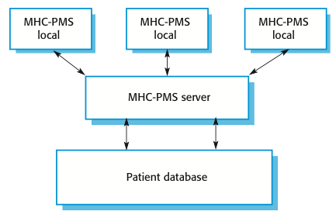
Organisation of the MHC-PMS
EXAMPLE

Slide 10
MHC-PMS key features
EXAMPLE
Individual care management
Clinicians can create records for patients, edit the information in the system, view patient history, etc. The system supports data summaries so that doctors can quickly learn about the key problems and treatments that have been prescribed
Patient monitoring
The system monitors the records of patients that are involved in treatment and issues warnings if possible problems are detected
Administrative reporting
The system generates monthly management reports showing the number of patients treated at each clinic, the number of patients who have entered and left the care system, number of patients sectioned, the drugs prescribed and their costs, etc.

Slide 11
MHC-PMS concerns
EXAMPLE
Privacy
It is essential that patient information is confidential and is never disclosed to anyone apart from authorised medical staff and the patient themselves
Safety
Some mental illnesses cause patients to become suicidal or a danger to other people. Wherever possible, the system should warn medical staff about potentially suicidal or dangerous patients
The system must be available when needed otherwise safety may be compromised and it may be impossible to prescribe the correct medication to patients

Slide 12
User and system requirements
EXAMPLE

Slide 13
Functional and non-functional requirements

Slide 14
Functional and non-functional requirements
Functional requirements
Statements of services the system should provide, how the system should react to particular inputs and how the system should behave in particular situations
May state what the system should not do
Non-functional requirements
Constraints on the services or functions offered by the system such as timing constraints, constraints on the development process, standards, etc.
Often apply to the system as a whole rather than individual features or services
Domain requirements
Constraints on the system from the domain of operation

Slide 15
MHC-PMS Functional requirements
EXAMPLE
A user shall be able to search the appointments lists for all clinics
The system shall generate each day, for each clinic, a list of patients who are expected to attend appointments that day
Each staff member using the system shall be uniquely identified by his or her 8-digit employee number

Slide 16
Non-functional requirements
Define system properties and constraints
e.g. reliability, response time and storage requirements
Constraints are I/O device capability, hardware limitations, etc.
Process requirements may also be specified
Mandating a particular IDE, programming language or development method
Non-functional requirements may be more critical than functional requirements
If these are not met, the system may be useless

Slide 17
Non-functional requirements implementation
Non-functional requirements may affect the overall architecture of a system rather than the individual components
E.g. to ensure that performance requirements are met, you may have to organize the system to minimize communications between components
A single non-functional requirement, such as a security requirement, may generate a number of related functional requirements that define system services that are required
It may also generate requirements that restrict existing requirements

Slide 18
Non-functional classifications
Product requirements
Requirements which specify that the delivered product must behave in a particular way e.g. execution speed, reliability, etc.
Organisational requirements
Requirements which are a consequence of organisational policies and procedures e.g. process standards used, implementation requirements, etc.
External requirements
Requirements which arise from factors which are external to the system and its development process e.g. interoperability requirements, legislative requirements, etc.
Legislative = created by legislation offices (e.g. parliament)
Regulatory = created by regulation agencies (e.g. environment regulation office)

Slide 19
MHC-PMS Examples of non-functional requirements
EXAMPLE
Product requirement The Mentcare system shall be available to all clinics during normal working hours (Mon–Fri, 0830–17.30). Downtime within normal working hours shall not exceed five seconds in any one day. Organizational requirement Users of the Mentcare system shall authenticate themselves using their health authority identity card. External requirement The system shall implement patient privacy provisions as set out in HStan-03-2006-priv.

Slide 20
Metrics for specifying nonfunctional requirements
Property | Measure
Speed | Processed transactions/second User/event response time Screen refresh time
Size | Mbytes Number of ROM chips
Ease of use | Training time Number of help frames
Reliability | Mean time to failure Probability of unavailability Rate of failure occurrence Availability
Robustness | Time to restart after failure Percentage of events causing failure Probability of data corruption on failure
Portability | Percentage of target dependent statements Number of target systems

Slide 21
Requirements engineering processes

Slide 22
Requirements engineering processes
The processes used for RE vary widely depending on the application domain, the people involved and the organisation developing the requirements
However, there are a number of generic activities common to all processes
Requirements elicitation
Requirements analysis
Requirements validation
Requirements management (including change)
In practice, RE is an iterative activity in which these processes are interleaved

Slide 23
A spiral view oF the requirements engineering process

Slide 24
Requirements elicitation

Slide 25
Requirements elicitation and analysis
Involves technical staff working with customers to find out about
The application domain
The services that the system should provide
The system’s operational constraints
May involve end-users, managers, engineers involved in maintenance, domain experts, trade unions, etc. i.e. stakeholders
Problems
Stakeholders don’t know what they really want
Stakeholders express requirements in their own terms
Different stakeholders may have conflicting requirements
Organisational factors may influence the system requirements
The requirements change during the analysis process
New stakeholders may emerge and the business environment may change

Slide 26
Process activities
Requirements discovery
Interacting with stakeholders to discover their requirements
Domain requirements also discovered at this stage
Requirements classification and organisation
Groups related requirements and organises them into coherent clusters
Prioritisation and negotiation
Prioritising requirements and resolving requirements conflicts
Requirements specification
Requirements are documented and input into the next round of the spiral

Slide 27
interviewing
Formal or informal interviews with stakeholders are part of most RE processes
Types of interview
Closed interviews based on pre-determined list of questions
Open interviews where various issues are explored with stakeholders
Effective interviewing
Be open-minded, avoid pre-conceived ideas about the requirements and be willing to listen
Prompt the interviewee to get discussions going using a springboard question, a requirements proposal, or by working together on a prototype system
In practice
A mix of closed and open-ended interviewing
Interviews are good for getting an overall understanding of what stakeholders do and how they might interact with the system
Interviews are not good for understanding domain requirements
Requirements engineers cannot understand specific domain terminology
Some domain knowledge is so familiar that people find it hard to articulate or think that it isn’t worth articulating

Slide 28
ethnography
A social scientist spends a considerable time observing and analysing how people actually work
People do not have to explain or articulate their work
Social and organisational factors of importance may be observed
Ethnographic studies have shown that work is usually richer and more complex than suggested by simple system models
Scope
Requirements that are derived from the way that people actually work rather than from process definitions suggesting the way that they ought to work
Requirements that are derived from cooperation and awareness of other people’s activities
Ethnography is effective for understanding existing processes but cannot identify new features that should be added to a system

Slide 29
Requirements specification

Slide 30
Requirements specification
The process of writing the user and system requirements in a requirements document
User requirements have to be understandable by end-users and customers who do not have a technical background
System requirements are more detailed requirements and may include more technical information
Requirements may be part of a contract for the system development
Important that these are as complete as possible

Slide 31
Ways of writing a system requirements specification
Notation | Description
Natural language | The requirements are written using numbered sentences in natural language. Each sentence should express one requirement.
Structured natural language | The requirements are written in natural language on a standard form or template. Each field provides information about an aspect of the requirement.
Graphical notations | Graphical models, supplemented by text annotations, are used to define the functional requirements for the system; UML use case and sequence diagrams are commonly used.
Mathematical specifications | These notations are based on mathematical concepts such as finite-state machines or sets. Although these unambiguous specifications can reduce the ambiguity in a requirements document, most customers don’t understand a formal specification. They cannot check that it represents what they want and are reluctant to accept it as a system contract

Slide 32
Natural language specification
Requirements are written as natural language sentences supplemented by diagrams and tables
Used for writing requirements because it is expressive, intuitive and universal
The requirements can be understood by users and customers
Problems
Lack of clarity
Precision is difficult without making the document difficult to read
Requirements confusion
Functional and non-functional requirements tend to be mixed-up
Requirements amalgamation
Several different requirements may be expressed together

Slide 33
Guidelines for writing requirements
Invent a standard format and use it for all requirements
Use language in a consistent way
Use shall for mandatory requirements, should for desirable requirements
Use text highlighting to identify key parts of the requirement
Avoid the use of computer jargon
Include an explanation (rationale) of why a requirement is necessary

Slide 34
Insulin pump control system
EXAMPLE
Collects data from a blood sugar sensor and calculates the amount of insulin required to be injected
Calculation based on the rate of change of blood sugar levels
Sends signals to a micro-pump to deliver the correct dose of insulin
Safety-critical system
Low blood sugars can lead to brain malfunctioning, coma and death
High-blood sugar levels have long-term consequences such as eye and kidney damage

Slide 35
Example requirements for insulin pump software system
EXAMPLE
3.2 The system shall measure the blood sugar and deliver insulin, if required, every 10 minutes. (Changes in blood sugar are relatively slow so more frequent measurement is unnecessary; less frequent measurement could lead to unnecessarily high sugar levels.) 3.6 The system shall run a self-test routine every minute with the conditions to be tested and the associated actions defined in Table 1. (A self-test routine can discover hardware and software problems and alert the user to the fact that normal operation may be impossible.)

Slide 36
Structured specifications
An approach to writing requirements where the freedom of the requirements writer is limited and requirements are written in a standard way
Sometimes too rigid

Slide 37
Form-based specifications
Definition of the function or entity
Description of inputs and where they come from
Description of outputs and where they go to
Information about the info needed for the computation
Description of the action to be taken
Pre and post conditions (if appropriate)
The side effects (if any) of the function

Slide 38
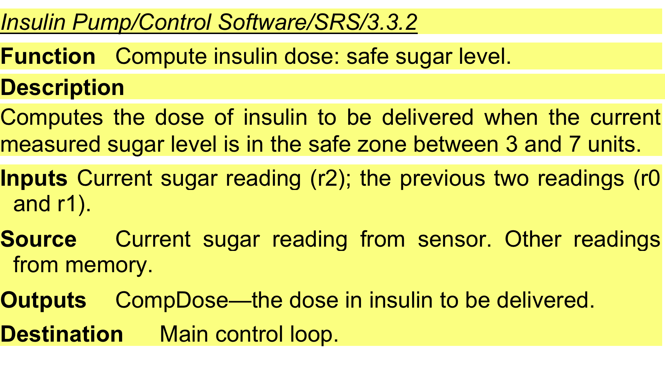
Structured spec of a requirement for an insulin pump
EXAMPLE

Slide 39
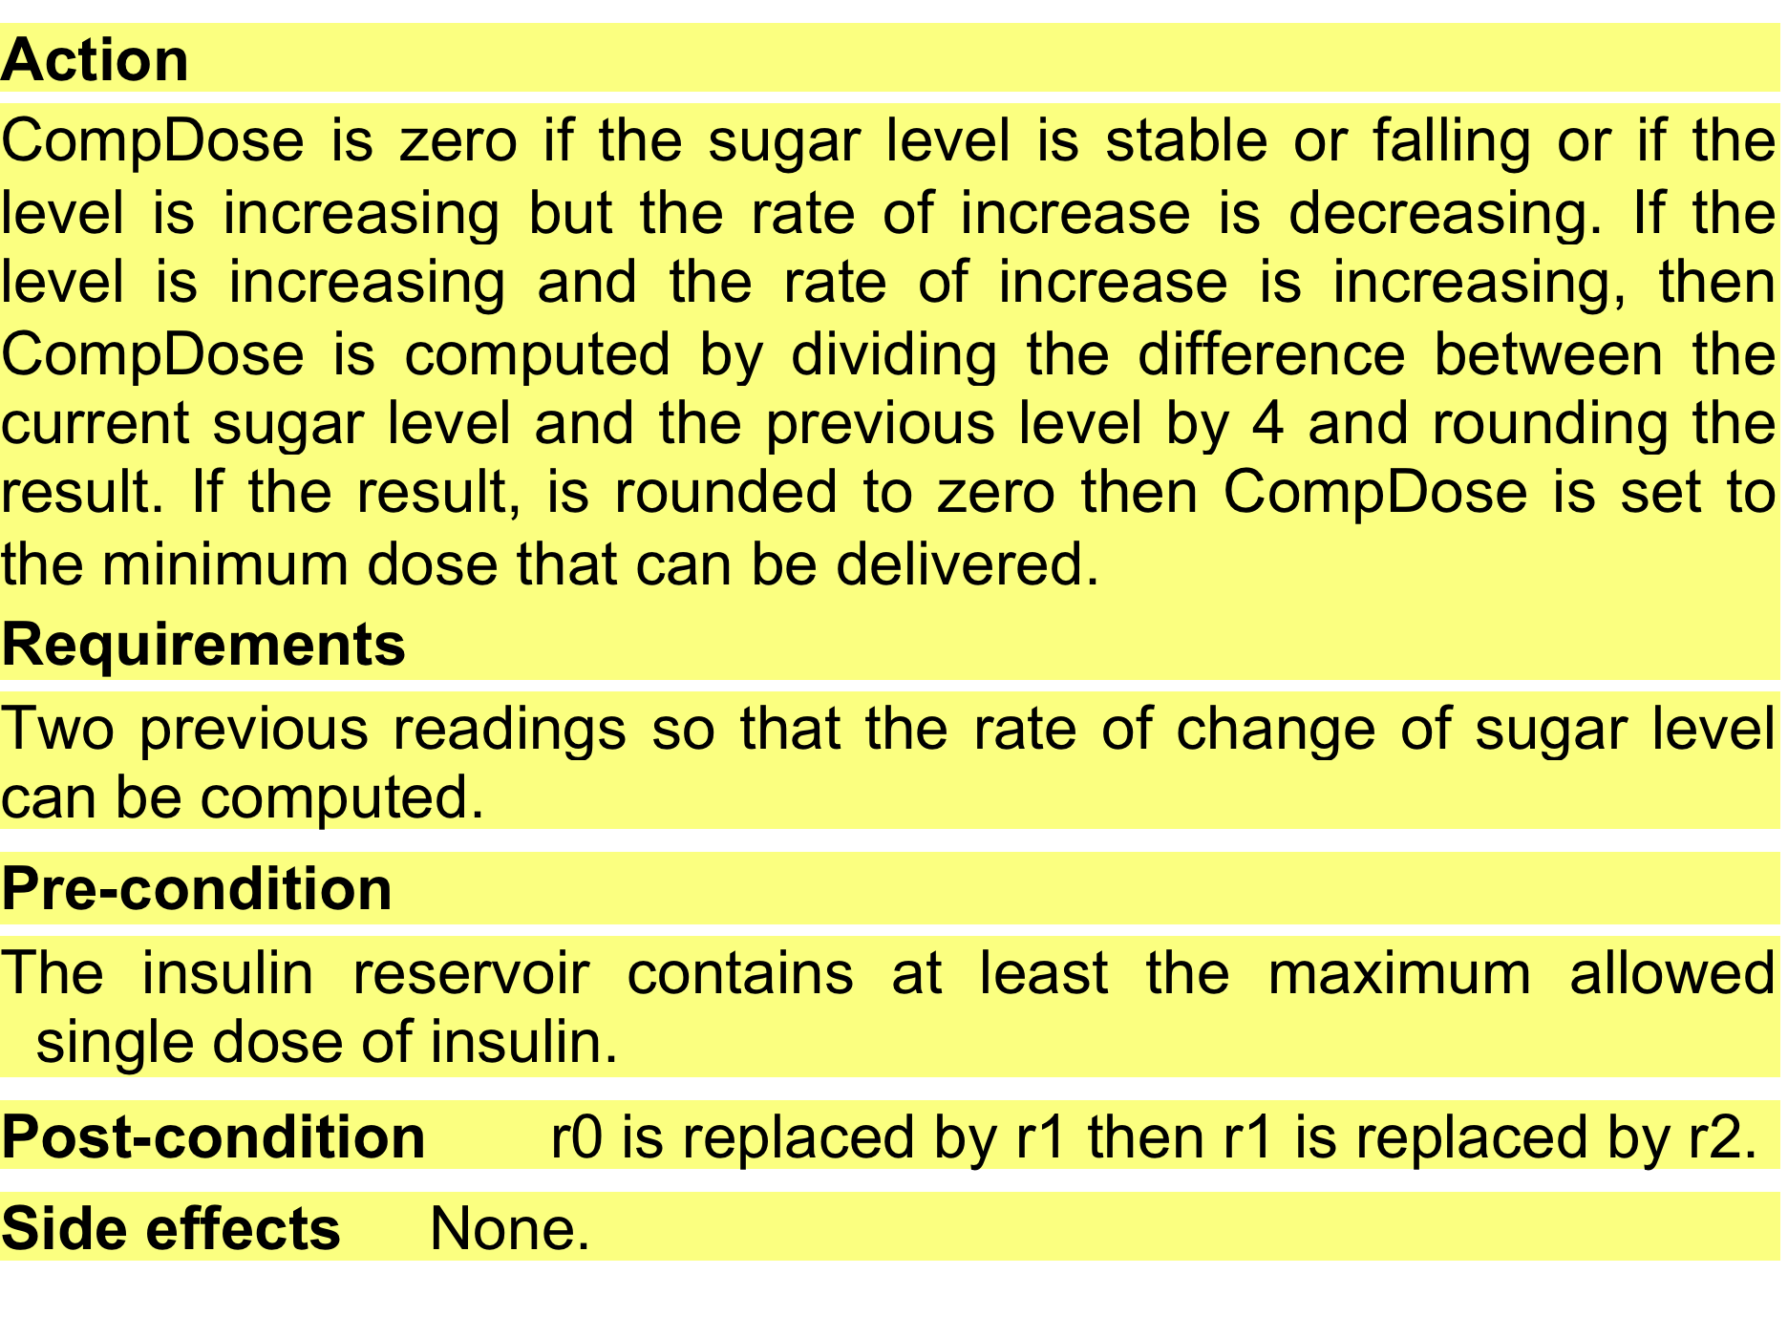
Structured spec of a requirement for an insulin pump
EXAMPLE

Slide 40
Tabular specification
Used to supplement natural language
Particularly useful when you have to define a number of possible alternative courses of action
For example, the insulin pump system bases its computations on the rate of change of blood sugar level and the tabular specification explains how to calculate the insulin requirement for different scenarios

Slide 41
Tabular specification of computation for an insulin pump
EXAMPLE
Condition | Action
Sugar level falling (r2 < r1) | CompDose = 0
Sugar level stable (r2 = r1) | CompDose = 0
Sugar level increasing and rate of increase decreasing ((r2 – r1) < (r1 – r0)) | CompDose = 0
Sugar level increasing and rate of increase stable or increasing ((r2 – r1) ≥ (r1 – r0)) | CompDose = round ((r2 – r1)/4) If rounded result = 0 then CompDose = MinimumDose

Slide 42
Use cases
Use-cases are a scenario based technique in the UML which identify the actors in an interaction and which describe the interaction itself
A set of use cases should describe all possible interactions with the system
Can be supplemented by more detailed tabular description
UML Sequence diagrams may be used to add detail to use-cases by showing the sequence of event processing in the system

Slide 43
MHC-PMS Use cases
EXAMPLE

Slide 44
The software requirements document
The software requirements document is the official statement of what is required of the system developers
Should include both a definition of user requirements and a specification of the system requirements
It is NOT a design document
As far as possible, it should set out WHAT the system should do rather than HOW it should do it

Slide 45
Requirements validation

Slide 46
Requirements validation
Concerned with demonstrating that the requirements define the system that the customer really wants
Requirements error costs are high so validation is very important
Fixing a requirements error after delivery may cost up to 100 times the cost of fixing an implementation error

Slide 47
Requirements checking
Validity
Does the system provide the functions which best support the customer’s needs?
Consistency
Are there any requirements conflicts?
Completeness
Are all functions required by the customer included?
Realism
Can the requirements be implemented given available budget and technology
Verifiability
Can the requirements be checked?

Slide 48
Requirements validation techniques
Requirements reviews
Regular systematic manual analysis of the requirements
Both client and contractor staff should be involved in reviews
Good communication between developers, customers and users can resolve problems at an early stage
Prototyping
Using an executable model of the system to check requirements
Test-case generation
Developing tests for requirements to check testability

Slide 49
Review checks
Verifiability
Is the requirement realistically testable?
Comprehensibility
Is the requirement properly understood?
Traceability
Is the origin of the requirement clearly stated?
Adaptability
Can the requirement be changed without a large impact on other requirements?

Slide 50
Requirements change

Slide 51
Changing requirements
The business and technical environment of the system always changes after installation
New hardware may be introduced
May be necessary to interface the system with other systems
Business priorities may change (with consequent changes in the system support required)
New legislation and regulations may be introduced that the system must necessarily abide by
The people who pay for a system and the users of that system are rarely the same people
System customers impose requirements because of organizational and budgetary constraints. These may conflict with end-user requirements and, after delivery, new features may have to be added for user support if the system is to meet its goals
Large systems usually have a diverse user community, with many users having different requirements and priorities that may be conflicting or contradictory
The final system requirements are inevitably a compromise between them and, with experience, it is often discovered that the balance of support given to different users has to be changed

Slide 52
Requirements management
Requirements management
Process of managing changing requirements during the requirements engineering process and system development
New requirements emerge as a system is being developed and after it has gone into use
You need to keep track of individual requirements and maintain links between dependent requirements so that you can assess the impact of requirements changes
You need to establish a formal process for making change proposals and linking these to system requirements

Slide 53
Requirements change management
Deciding if a requirements change should be accepted
Problem analysis and change specification
During this stage, the problem or the change proposal is analyzed to check that it is valid. This analysis is fed back to the change requestor who may respond with a more specific requirements change proposal, or decide to withdraw the request
Change analysis and costing
The effect of the proposed change is assessed using traceability information and general knowledge of the system requirements. Once this analysis is completed, a decision is made whether or not to proceed with the requirements change.
Change implementation
The requirements document and, where necessary, the system design and implementation, are modified. Ideally, the document should be organized so that changes can be easily implemented.

Slide 54
Key points

Slide 55
Key points
Requirements for a software system
Set out what the system should do and define constraints on its operation and implementation
Functional requirements
Statements of the services that the system must provide
Descriptions of how some computations must be carried out
Non-functional requirements
Constrain the system being developed and the development process being used
Often relate to the emergent properties of the system and therefore apply to the system as a whole

Slide 56
Key points
The requirements engineering process
Iterative process including requirements elicitation, specification and validation
Requirements elicitation and analysis
Iterative process that can be represented as a spiral of activities
Requirements discovery, requirements classification and organization, requirements negotiation and requirements documentation
You can use a range of techniques including interviews, scenarios, use-cases and ethnography
Requirements specification is the process of formally documenting the user and system requirements and creating a software requirements document
The requirements document is an agreed statement of the system requirements
Should be organized so that both system customers and software developers can use it

Slide 57
Key points
Requirements validation is the process of checking the requirements for validity, consistency, completeness, realism and verifiability
Business, organizational and technical changes inevitably lead to changes to the requirements for a software system
Requirements management is the process of managing and controlling these changes

Slide 58
